Slide 1
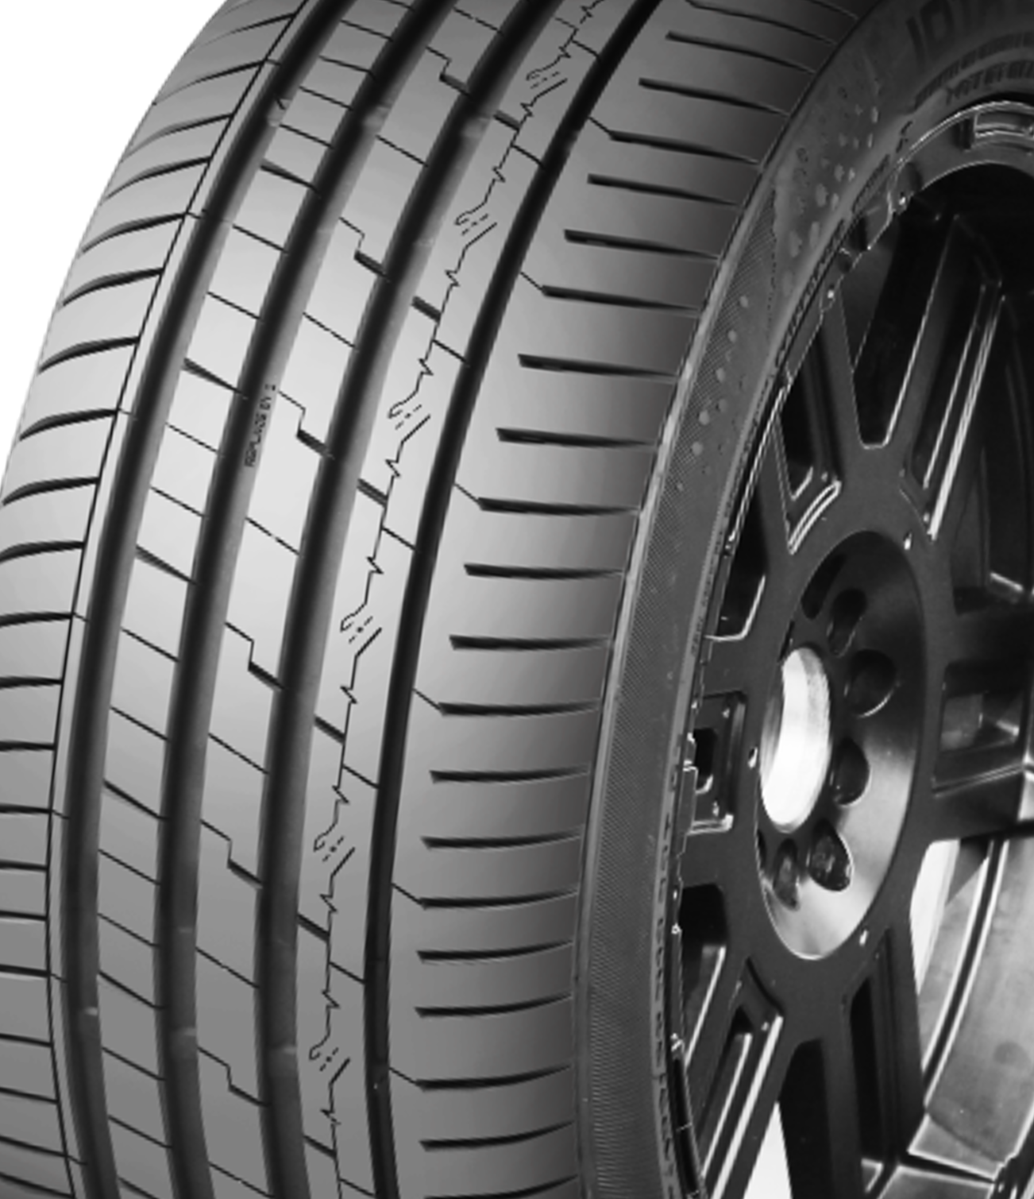

IOTA EVT
ENERGY-OPTIMIZED VEHICLE TYRE

Slide 2
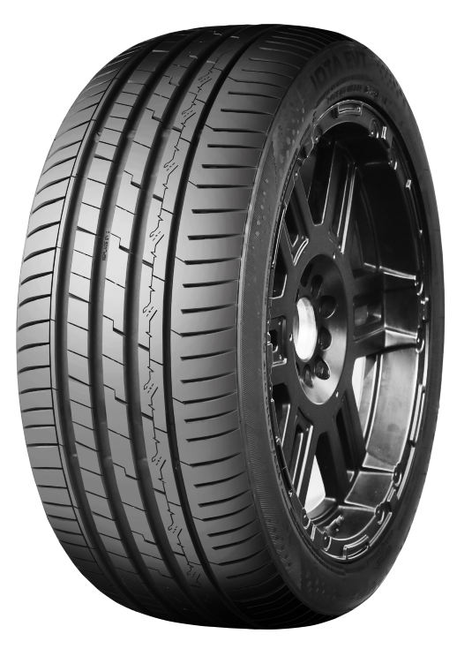
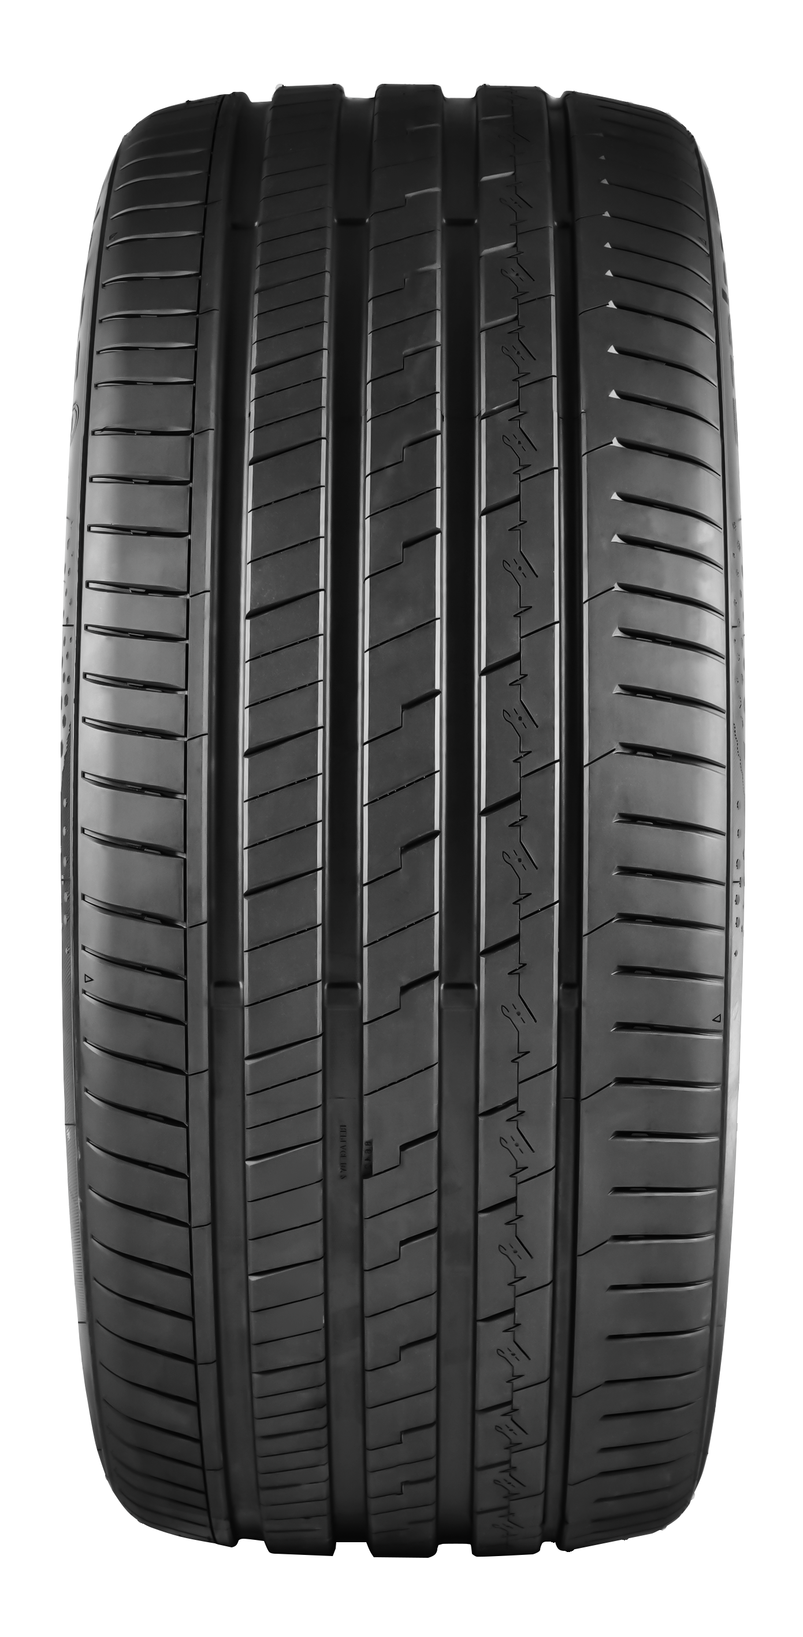
ACCELERA IOTA EVT
The Accelera Iota EVT (Energy-Optimized Vehicle Tyre) is an innovative tire solution from Accelera Tires designed to deliver optimal performance for both electric vehicles (EVs) and conventional internal combustion engine (ICE) vehicles. Featuring the latest technology, this tire offers high energy efficiency, enhanced grip, and outstanding driving comfort. With a design focused on reducing rolling resistance and energy consumption, the Accelera Iota EVT is ready to provide a more fuel-efficient and environmentally friendly driving experience for both electric and conventional vehicles.

Slide 3
WHY SHOULD YOU CHOOSE
IOTA EVT
Maximum Efficiency:
Engineered to minimize rolling resistance, allowing you to enjoy longer driving range with every charge and improved fuel efficiency.
Quieter Performance
Experience a more peaceful journey with reduced road noise, perfectly
Notes:
© Copyright Showeet.com – Free PowerPoint Templates

Slide 4
WHY SHOULD YOU CHOOSE
IOTA EVT
Optimal Grip:
Electric vehicles with high torque require exceptional grip. The Accelera Iota EVT delivers optimal traction and handling performance, ensuring better control and driving stability.
Suitable for All Vehicles:
The Accelera Iota EVT is designed to be compatible with conventional vehicles. Developed with a specialized compound and equipped with technologies such as low rolling resistance, low noise, and high durability, this tire ensures a smooth and quiet driving experience for conventional car users. Its combination of outstanding performance and durability makes the Iota EVT a highly versatile choice.
Notes:
© Copyright Showeet.com – Free PowerPoint Templates

Slide 5
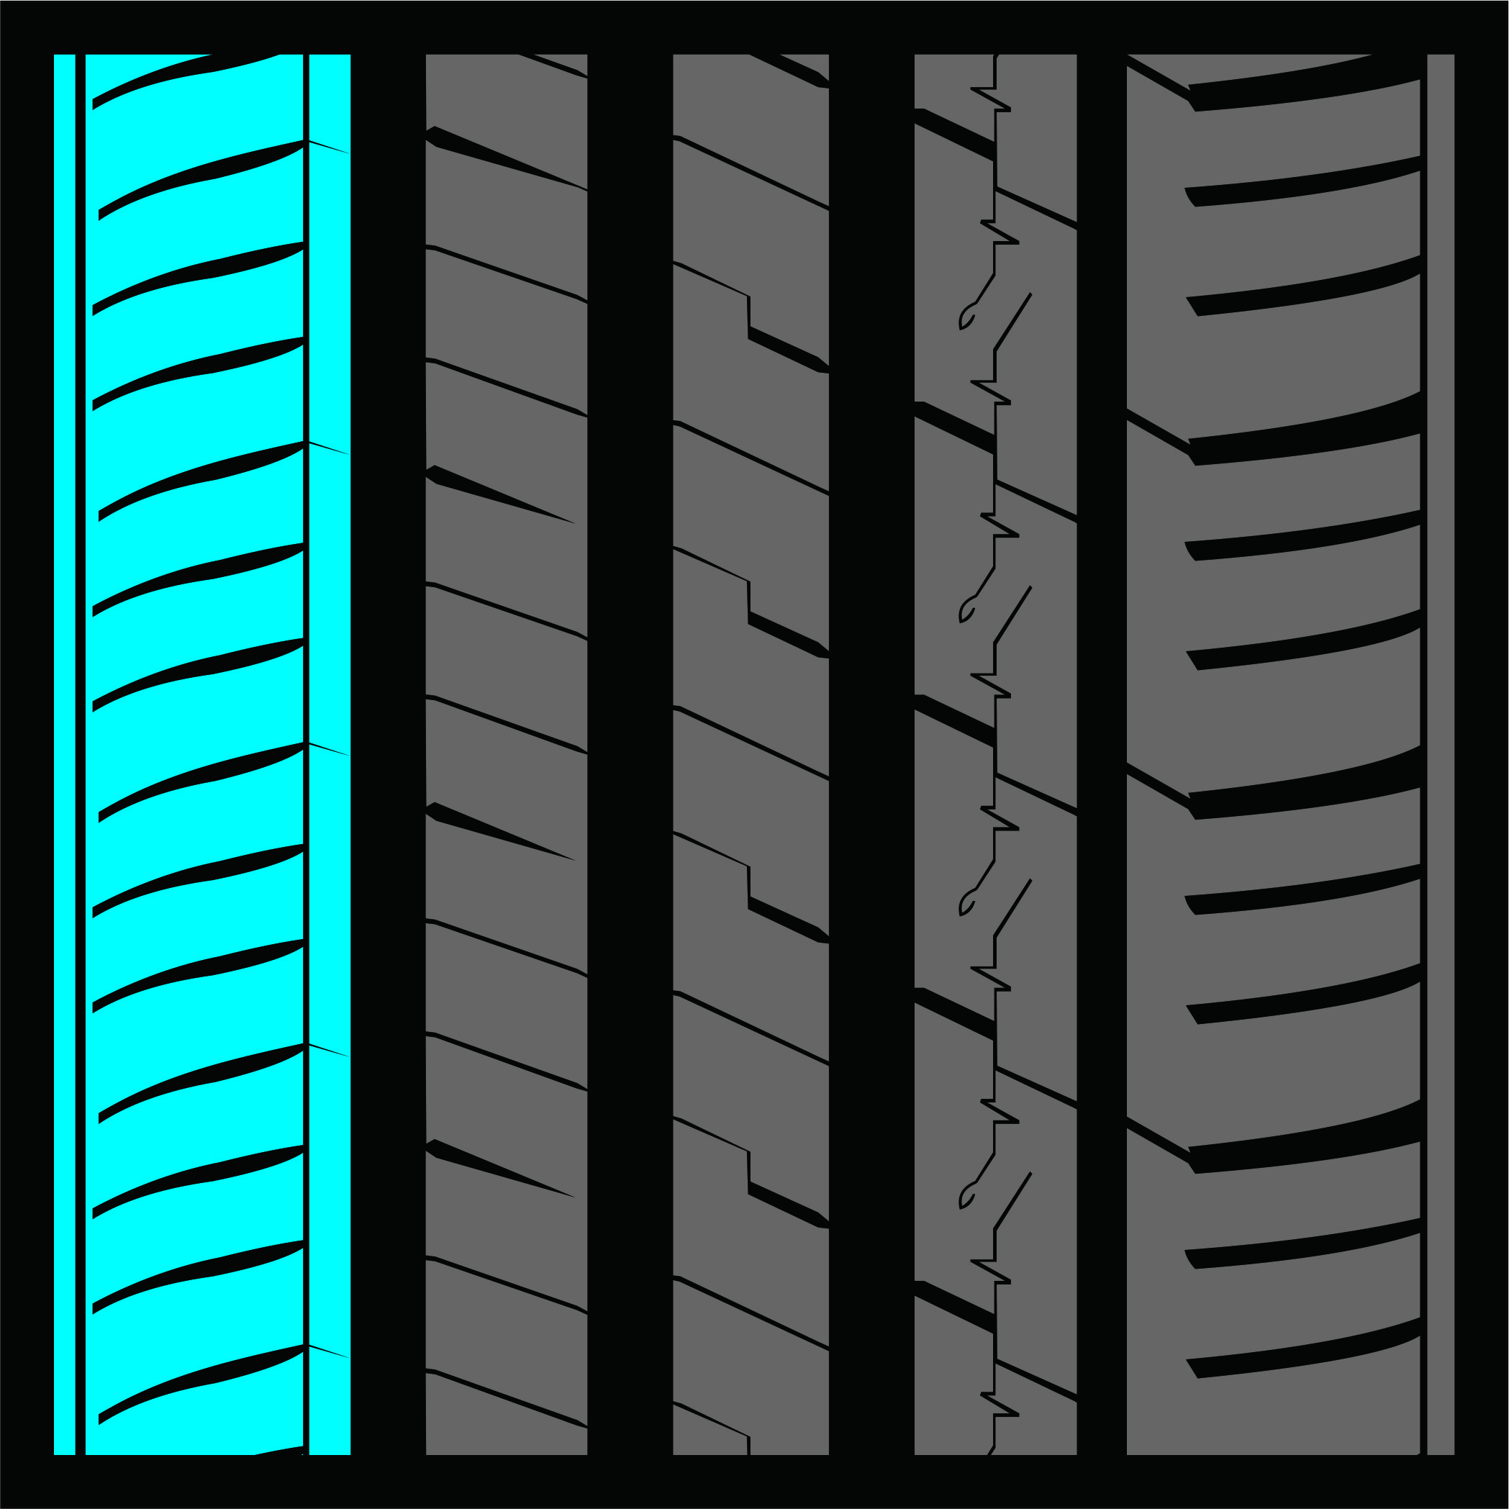
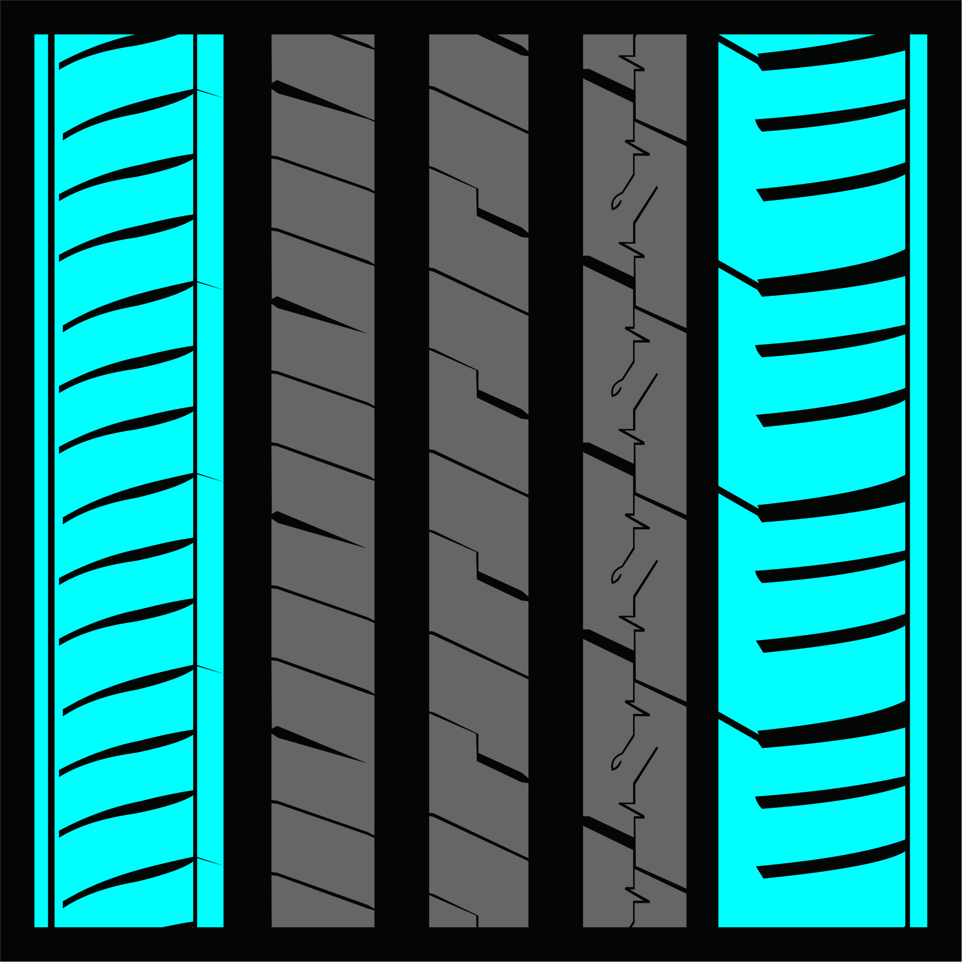

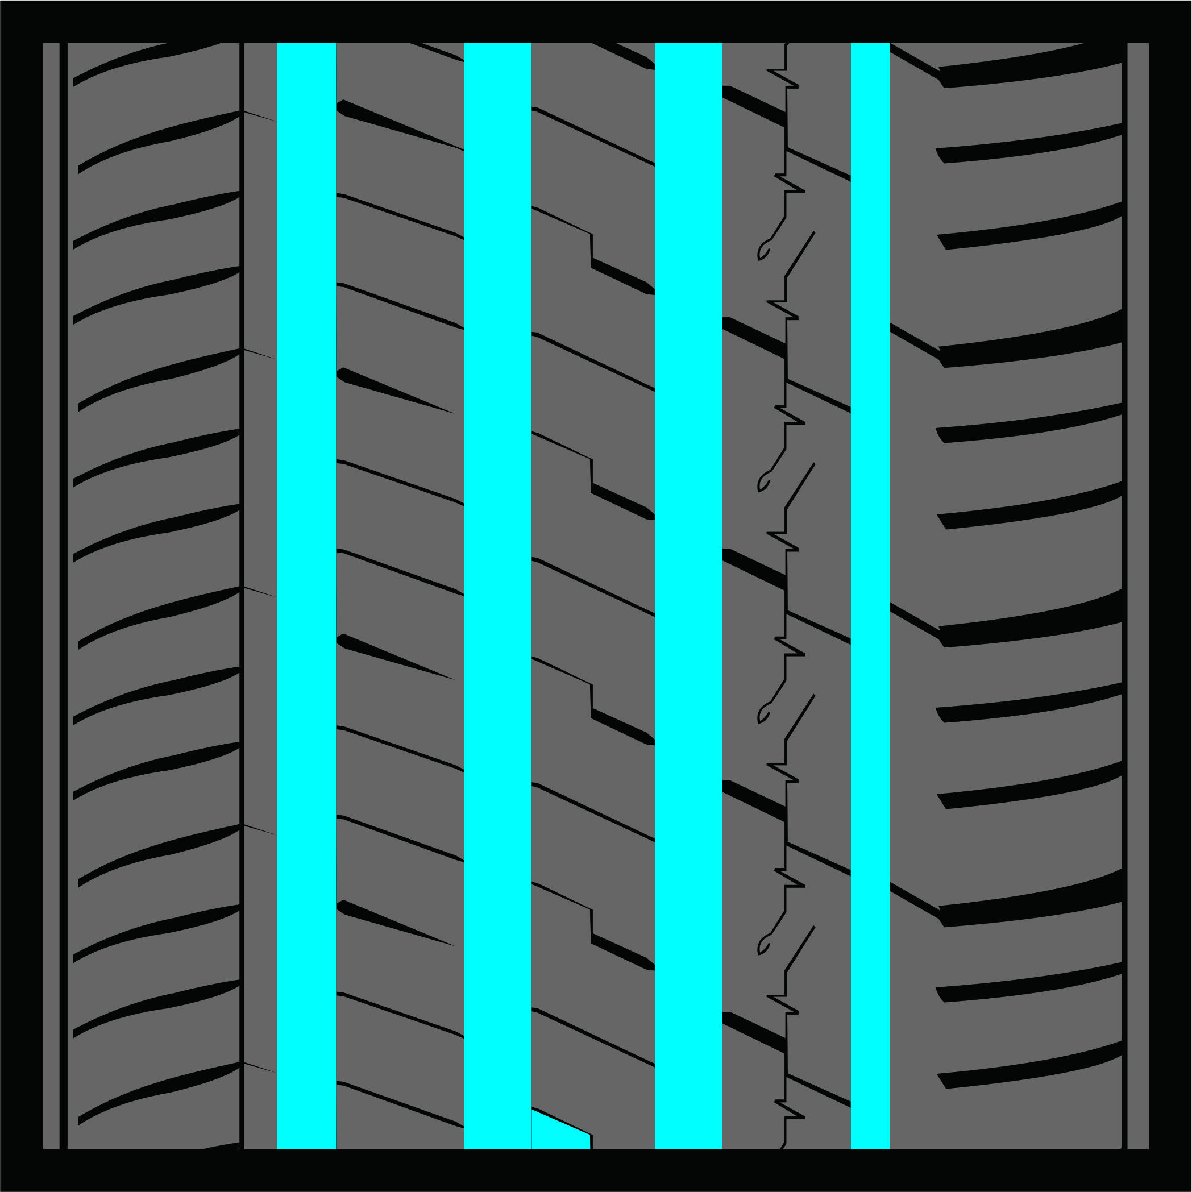
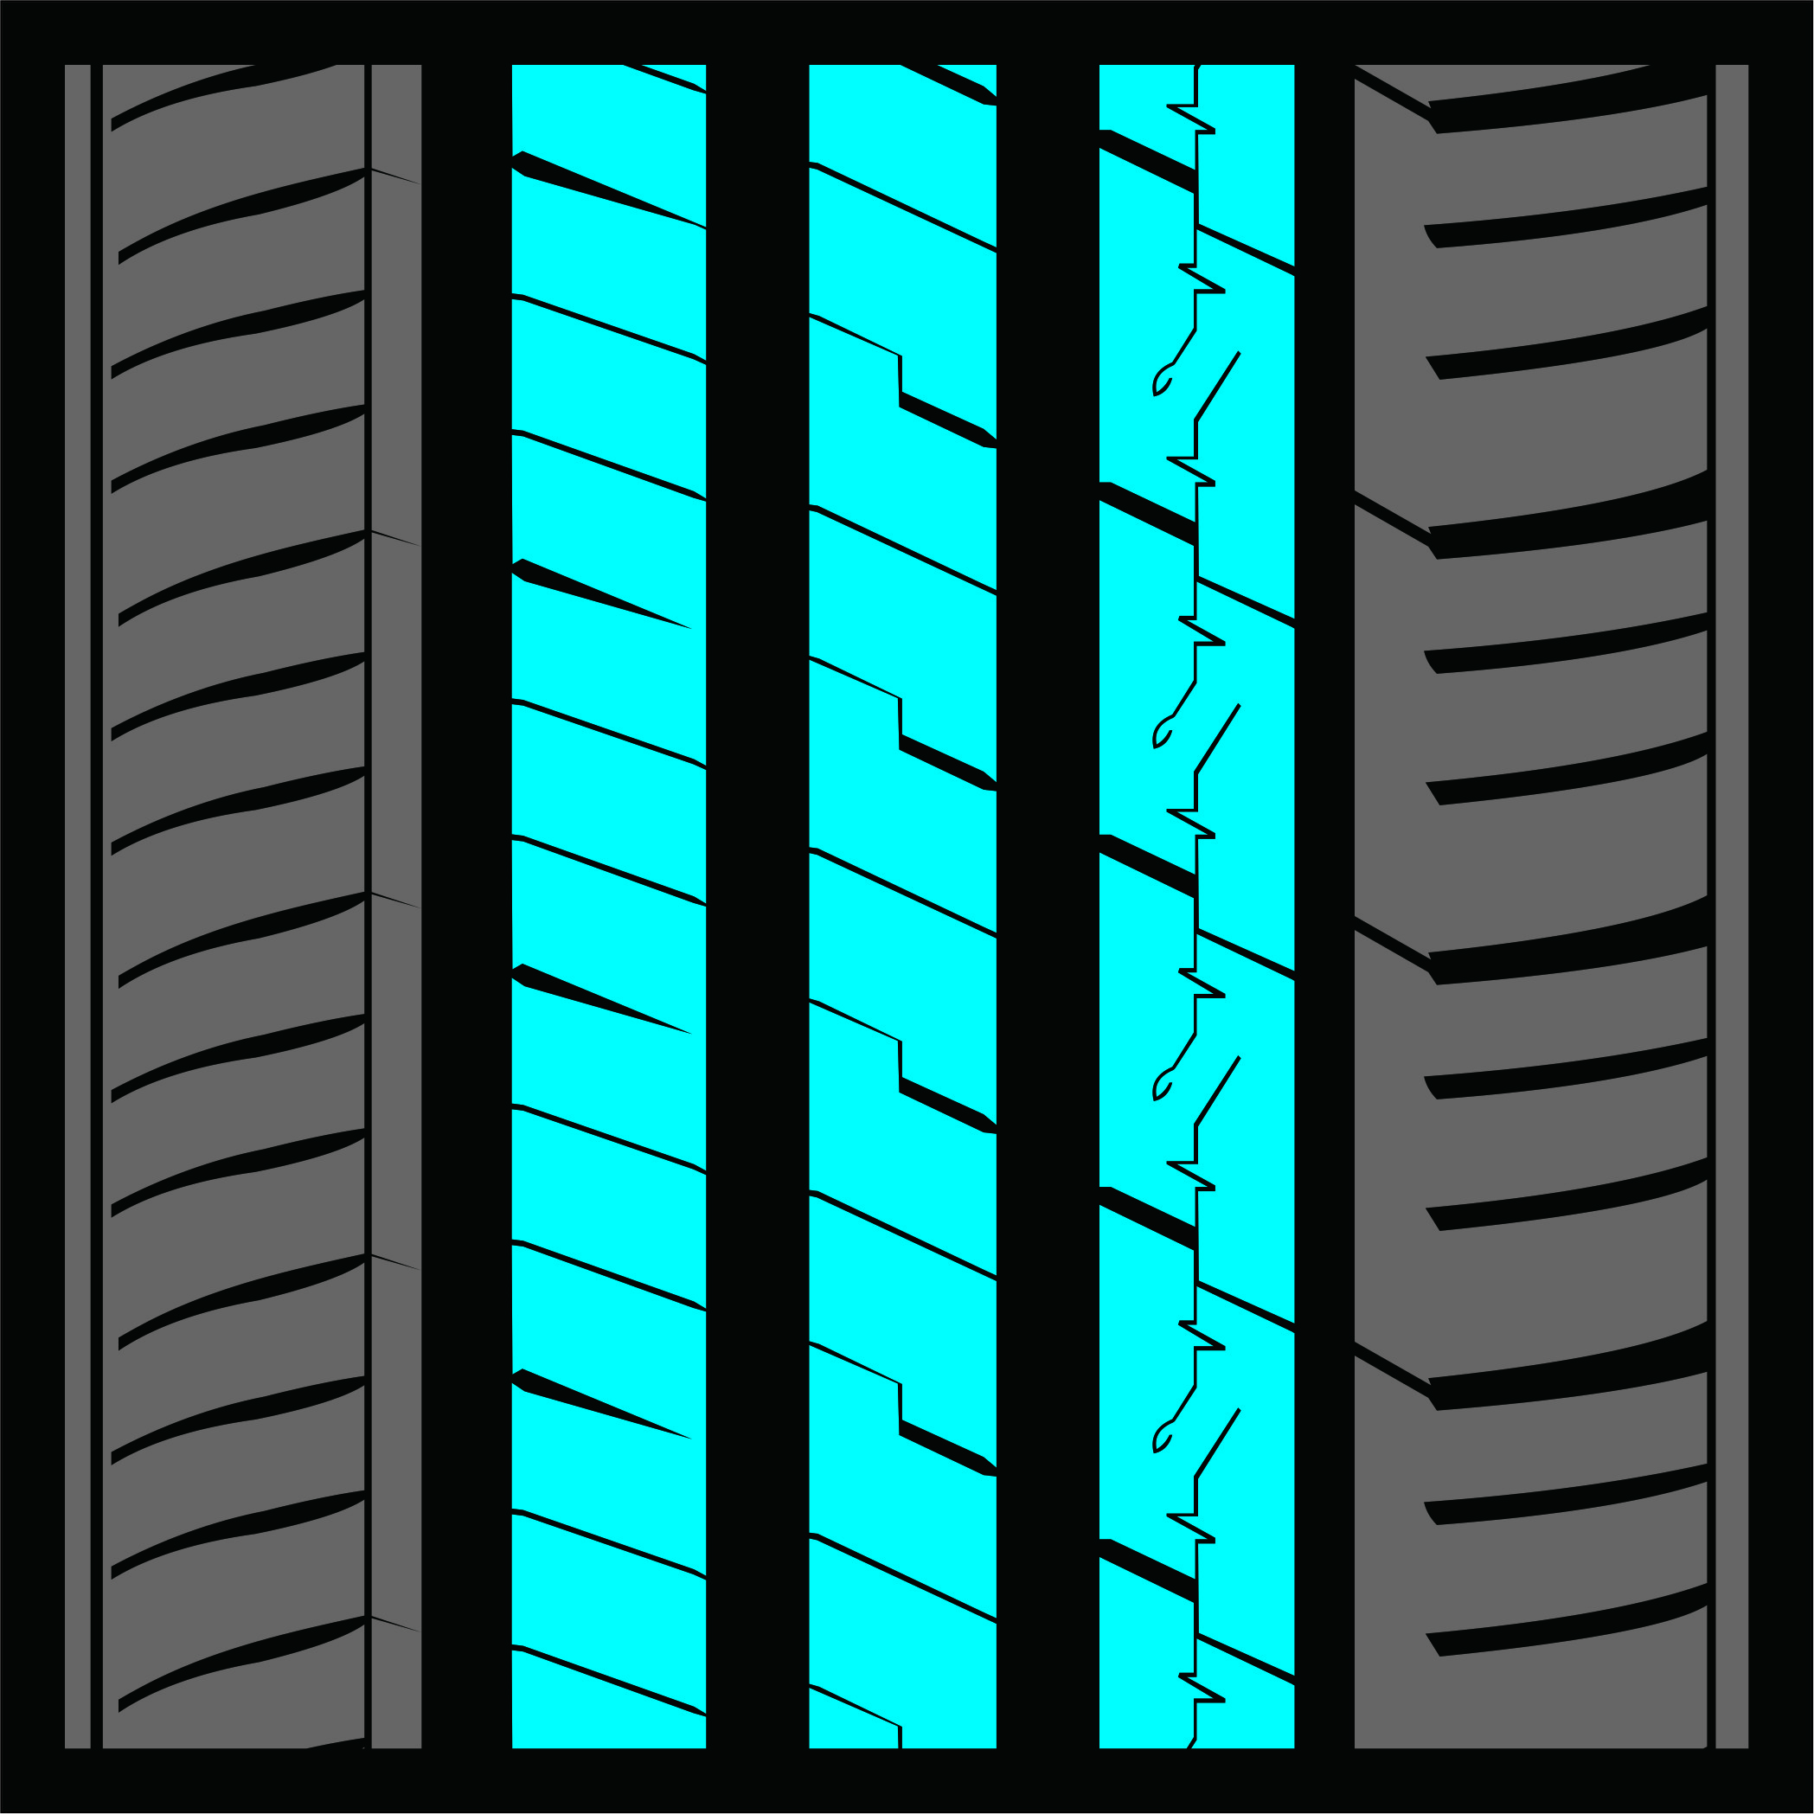
DETAIL TELAPAK IOTA EVT
Optimal tread block arrangement and pitch sequence
Delivers a quiet and comfortable driving experience.
Strong shoulder blocks
Ensure cornering stability and excellent maneuverability.
Asymmetrical and non-directional tread pattern
Allows cross rotation, helping maintain consistent noise performance throughout the tire’s lifespan.
Four wide circumferential grooves
Provide outstanding aquaplaning resistance and improved wet traction.
Three solid center ribs with multiple grooves
Designed for high-speed stability and enhanced traction.

Slide 6
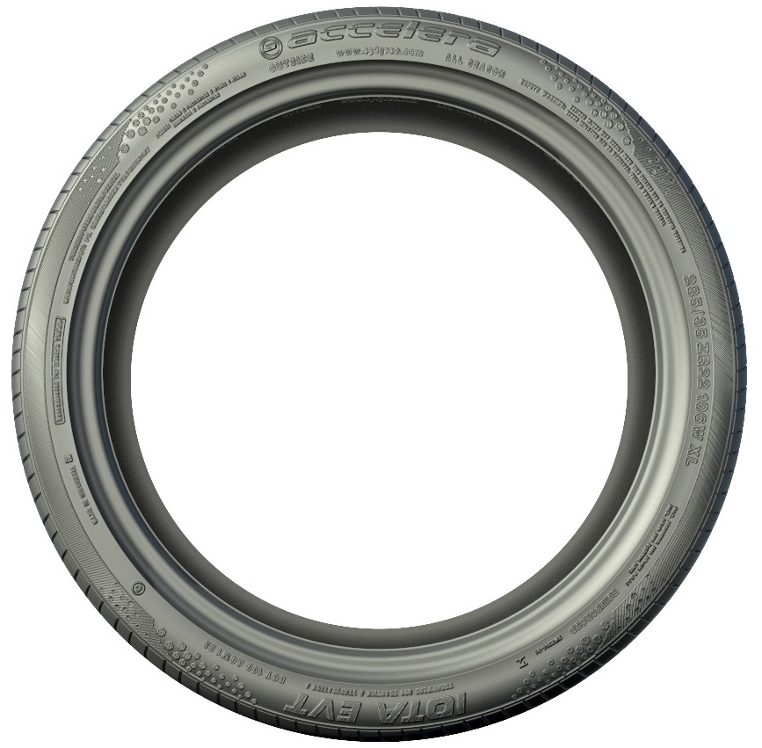
PRODUCT APPEREANCE – iota evt

Slide 7
UKURAN IOTA EVT
255/30 ZR22
245/35 ZR22
285/35 ZR22
245/25 ZR21
255/25 ZR21
295/25 ZR21
235/30 ZR21
245/30 ZR21
255/30 ZR21
275/30 ZR21
245/35 ZR21
255/35 ZR21
245/40 ZR21
275/25 ZR20
285/25 ZR20
215/30 ZR20
225/30 ZR20
235/30 ZR20
245/30 ZR20
255/30 ZR20
275/30 ZR20
285/30 ZR20
295/30 ZR20
305/30 ZR20
225/35 ZR20
235/35 ZR20
245/35 ZR20
255/35 ZR20
275/35 ZR20
225/40 ZR20
245/40 ZR20
255/40 ZR20
245/45 ZR20
255/30 ZR19
265/30 ZR19
275/30 ZR19
285/30 ZR19
295/30 ZR19
215/35 ZR19
225/35 ZR19
235/35 ZR19
245/35 ZR19
255/35 ZR19
265/35 ZR19
275/35 ZR19
285/35 ZR19
225/40 ZR19
235/40 ZR19
245/40 ZR19
255/40 ZR19
275/40 ZR19
225/45 ZR19
235/45 ZR19
245/45 ZR19
255/45 ZR19
175/60 R19
155/70 R19
225/35 ZR18
245/35 ZR18
255/35 ZR18
265/35 ZR18
275/35 ZR18
205/40 ZR18
215/40 ZR18
225/40 ZR18
235/40 ZR18
245/40 ZR18
255/40 ZR18
275/40 ZR18
205/45 ZR18
215/45 ZR18
225/45 ZR18
235/45 ZR18
245/45 ZR18
255/45 ZR18
215/50 ZR18
225/50 ZR18
235/50 ZR18
245/50 ZR18
185/35 R17
225/35 ZR17
165/40 R17
195/40 R17
205/40 ZR17
215/40 ZR17
245/40 ZR17
255/40 ZR17
205/45 ZR17
215/45 ZR17
225/45 ZR17
235/45 ZR17
245/45 ZR17
205/50 ZR17
215/50 ZR17
225/50 ZR17
235/50 ZR17
245/50 ZR17
205/55 R17
215/55 ZR17
225/55 ZR17
235/55 ZR17
245/55 ZR17
205/40 ZR16
195/45 ZR16
205/45 ZR16
215/45 ZR16
165/50 R16
185/50 R16
195/50 R16
205/50 ZR16
225/50 ZR16
185/55 R16
195/55 R16
205/55 ZR16
215/55 ZR16
225/55 ZR16
235/60 ZR16
195/45 R15
175/50 R15
195/50 R15
205/50 ZR15
165/55 R15
175/55 R15
185/55 R15
195/55 R15
205/55 R15
205/60 R14

Slide 8
KONTEN PRODUK
Website :
  https://accelera-radial.com/products/details/iota-evt
Product Video
  https://www.youtube.com/watch?v=NggWY2YY65E
Product Photo
  https://drive.google.com/drive/folders/1Jk6dygNqF-uqrQ3F7RpjfAoeic6GSanM?usp=drive_link

